Slide 1
Syllabus
The divisions of the nervous system: central and peripheral (somatic and autonomic).
The structure and function of sensory, relay and motor neurons. The process of synaptic transmission, including reference to neurotransmitters, excitation and inhibition.
The function of the endocrine system: glands and hormones.
The fight or flight response including the role of adrenaline.
Localisation of function in the brain and hemispheric lateralisation: motor, somatosensory, visual, auditory and language centres; Broca’s and Wernicke’s areas, split brain research. Plasticity and functional recovery of the brain after trauma.
Ways of studying the brain: scanning techniques, including functional magnetic resonance imaging (fMRI); electroencephalogram (EEGs) and event-related potentials (ERPs); post-mortem examinations.
Biological rhythms: circadian, infradian and ultradian and the difference between these rhythms.
  The effect of endogenous pacemakers and exogenous zeitgebers on the sleep/wake cycle.

Slide 2
Ways of studying the brain: scanning techniques, including functional magnetic resonance imaging (fMRI); electroencephalogram (EEGs) and event-related potentials (ERPs); post-mortem examinations.
https://youtu.be/MiL0wCZr0Mw

Slide 3
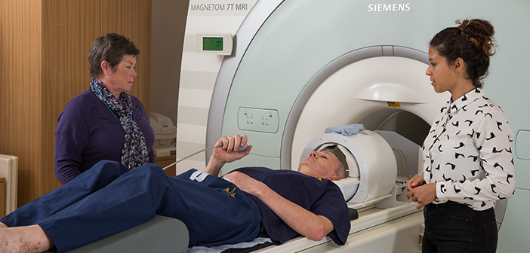
functional magnetic resonance imaging (fMRI)

Slide 4
FMRI (read)
FMRI is one of the most recently developed forms of neuroimaging but the idea underpinning the technique - inferring brain activity by measuring changes in blood flow - is not new. The following account of an experiment performed by the Italian scientist Angelo Mosso (left) can be found in William James’ The Principles of Psychology, published in 1890:
'The subject to be observed lay on a delicately balanced table which could tip downwards either at the head or the foot if the weight of either end were increased. The moment emotional or intellectual activity began in the subject, down went the balance at the head-end, in consequence of the redistribution of blood in his system…'

Slide 5
FMRI
The development of FMRI in the 1990s, generally credited to Seiji Ogawa and Ken Kwong, is the latest in long line of innovations, including positron emission tomography (PET) and near infrared spectroscopy (NIRS), which use blood flow and oxygen metabolism to infer brain activity. As a brain imaging technique FMRI has several significant advantages:
It is non-invasive and doesn’t involve radiation, making it safe for the subject.
It has excellent spatial and good temporal resolution.
It is easy for the experimenter to use.
The attractions of FMRI have made it a popular tool for imaging normal brain function – especially for psychologists. Over the last decade it has provided new insight to the investigation of how memories are formed, language, pain, learning and emotion to name but a few areas of research. FMRI is also being applied in clinical and commercial settings.

Slide 6
WHAT MRI MEASURES
The cylindrical tube of an MRI scanner houses a very powerful electro-magnet. A typical research scanner (such as the FMRIB Centre scanner) has a field strength of 3 teslas (T), about 50,000 times greater than the Earth’s field. The magnetic field inside the scanner affects the magnetic nuclei of atoms. Normally atomic nuclei are randomly oriented but under the influence of a magnetic field the nuclei become aligned with the direction of the field. The stronger the field the greater the degree of alignment. When pointing in the same direction, the tiny magnetic signals from individual nuclei add up coherently resulting in a signal that is large enough to measure. In FMRI it is the magnetic signal from hydrogen nuclei in water (H₂O) that is detected. The key to MRI is that the signal from hydrogen nuclei varies in strength depending on the surroundings. This provides a means of discriminating between grey matter, white matter and cerebral spinal fluid in structural images of the brain.

Slide 7
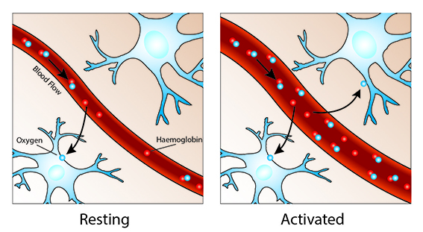
WHAT FMRI MEASURES
Oxygen is delivered to neurons by haemoglobin in capillary red blood cells. When neuronal activity increases there is an increased demand for oxygen and the local response is an increase in blood flow to regions of increased neural activity.
Haemoglobin is diamagnetic when oxygenated but paramagnetic when deoxygenated. This difference in magnetic properties leads to small differences in the MR signal of blood depending on the degree of oxygenation. Since blood oxygenation varies according to the levels of neural activity these differences can be used to detect brain activity. This form of MRI is known as blood oxygenation level dependent (BOLD) imaging.

Slide 8
One point to note is the direction of oxygenation change with increased activity. You might expect blood oxygenation to decrease with activation, but the reality is a little more complex. There is a momentary decrease in blood oxygenation immediately after neural activity increases, known as the “initial dip” in the haemodynamic response. This is followed by a period where the blood flow increases, not just to a level where oxygen demand is met, but overcompensating for the increased demand. This means the blood oxygenation actually increases following neural activation. The blood flow peaks after around 6 seconds and then falls back to baseline, often accompanied by a “post-stimulus undershoot”.

Slide 9
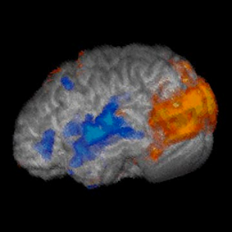
ACTIVATION MAPS
The image shown is the result of the simplest kind of FMRI experiment. While lying in the MRI scanner the subject watched a screen which alternated between showing a visual stimulus and being dark every 30 second. Meanwhile the MRI scanner tracked the signal throughout the brain. In brain areas responding to the visual stimulus you would expect the signal to go up and down as the stimulus is turned on and off, albeit blurred slightly by the delay in the blood flow response. The ‘activity’ in a voxel is defined as how closely the time-course of the signal from that voxel matches the expected time-course. Voxels whose signal corresponds tightly are given a high activation score, voxels showing no correlation have a low score and voxels showing the opposite (deactivation) are given a negative score. These can then be translated into activation maps.

Slide 10
Watch This.
https://www.youtube.com/watch?v=0uSYLy9itgg

Slide 11
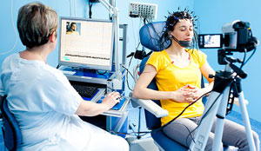
Electroencephalogram (EEGs)
An electroencephalogram (EEG) is a recording of brain activity.
During the test, small sensors are attached to the scalp to pick up the electrical signals produced when brain cells send messages to each other.
These signals are recorded by a machine and are looked at by a doctor later to see if they're unusual.
The EEG procedure is usually carried out by a highly trained specialist called a clinical neurophysiologist during a short visit to hospital.
https://www.youtube.com/watch?v=XMizSSOejg0

Slide 12
When an EEG is used
An EEG can be used to help diagnose and monitor a number of conditions affecting the brain.
It may help identify the cause of certain symptoms – such as seizures (fits) or memory problems – or find out more about a condition you've already been diagnosed with.
The main use of an EEG is to detect and investigate epilepsy, a condition that causes repeated seizures. An EEG will help your doctor identify the type of epilepsy you have, what may be triggering your seizures, and how best to treat you.
Less often, an EEG may be used to investigate other problems, such as dementia, head injuries, brain tumours, encephalitis (brain inflammation) and sleep disorders, such as obstructive sleep apnoea.

Slide 13
How an EEG is carried out
There are several different ways an EEG recording can be taken. The clinical neurophysiologist will explain the procedure to you and can answer any questions you have. You'll also be asked whether you give permission (consent) for the various parts of the test to be carried out.
Before the test starts, your scalp will be cleaned and about 20 small sensors called electrodes will be attached using a special glue or paste. These are connected by wires to an EEG recording machine.
Routine EEG recordings usually take 20 to 40 minutes, although a typical appointment will last about an hour, including some preparation time at the beginning and some time at the end. Other types of EEG recording may take longer.

Slide 14
Types of EEG
The main types of EEG are explained below.
Routine EEG
  A routine EEG recording lasts for about 20 to 40 minutes.
  During the test, you'll be asked to rest quietly and open or close your eyes from time to time. In most cases, you'll also be asked to breathe in and out deeply (known as hyperventilation) for a few minutes.
  At the end of the procedure a flashing light may be placed nearby to see if this affects your brain activity.
Sleep EEG or sleep-deprived EEG
  A sleep EEG is carried out while you're asleep. It may be used if a routine EEG doesn't give enough information, or to test for sleep disorders.
  In some cases, you may be asked to stay awake the night before the test to help ensure you can sleep while it's carried out. This is called a sleep-deprived EEG.
Ambulatory EEG
  An ambulatory EEG is where brain activity is recorded throughout the day and night over a period of one or more days. The electrodes will be attached to a small portable EEG recorder that can be clipped on to your clothing.
  You can continue with most of your normal daily activities while the recording is being taken, although you'll need to avoid getting the equipment wet.
Video telemetry
  Video telemetry, also known as video EEG, is a special type of EEG where you're filmed while a recording is taken. This can help provide more information about your brain activity.
  The test is usually carried out over a few days while staying in a purpose-built hospital suite.
  The EEG signals are transmitted wirelessly to a computer. The video is also recorded by the computer and kept under regular surveillance by trained staff.

Slide 15
Are there any risks or side effects?
The EEG procedure is painless, comfortable and generally very safe. No electricity is put into your body while it's carried out. Apart from having messy hair and possibly feeling a bit tired, you won't normally experience any after effects.
However, you may feel lightheaded and notice a tingling in your lips and fingers for a few minutes during the hyperventilation part of the test. Some people develop a mild rash where the electrodes were attached.
There's a very small risk you could have a seizure while the test is carried out, but you'll be closely monitored and help will be on hand in case this happens.

Slide 16
Event-related potentials (ERPs)
https://www.youtube.com/watch?v=PSoPsRPGjs4

Slide 17
If you feel queasy do not watch this
https://www.youtube.com/watch?v=jHxyP-nUhUY
Check out page 239 and note classic case study

